Slide 1
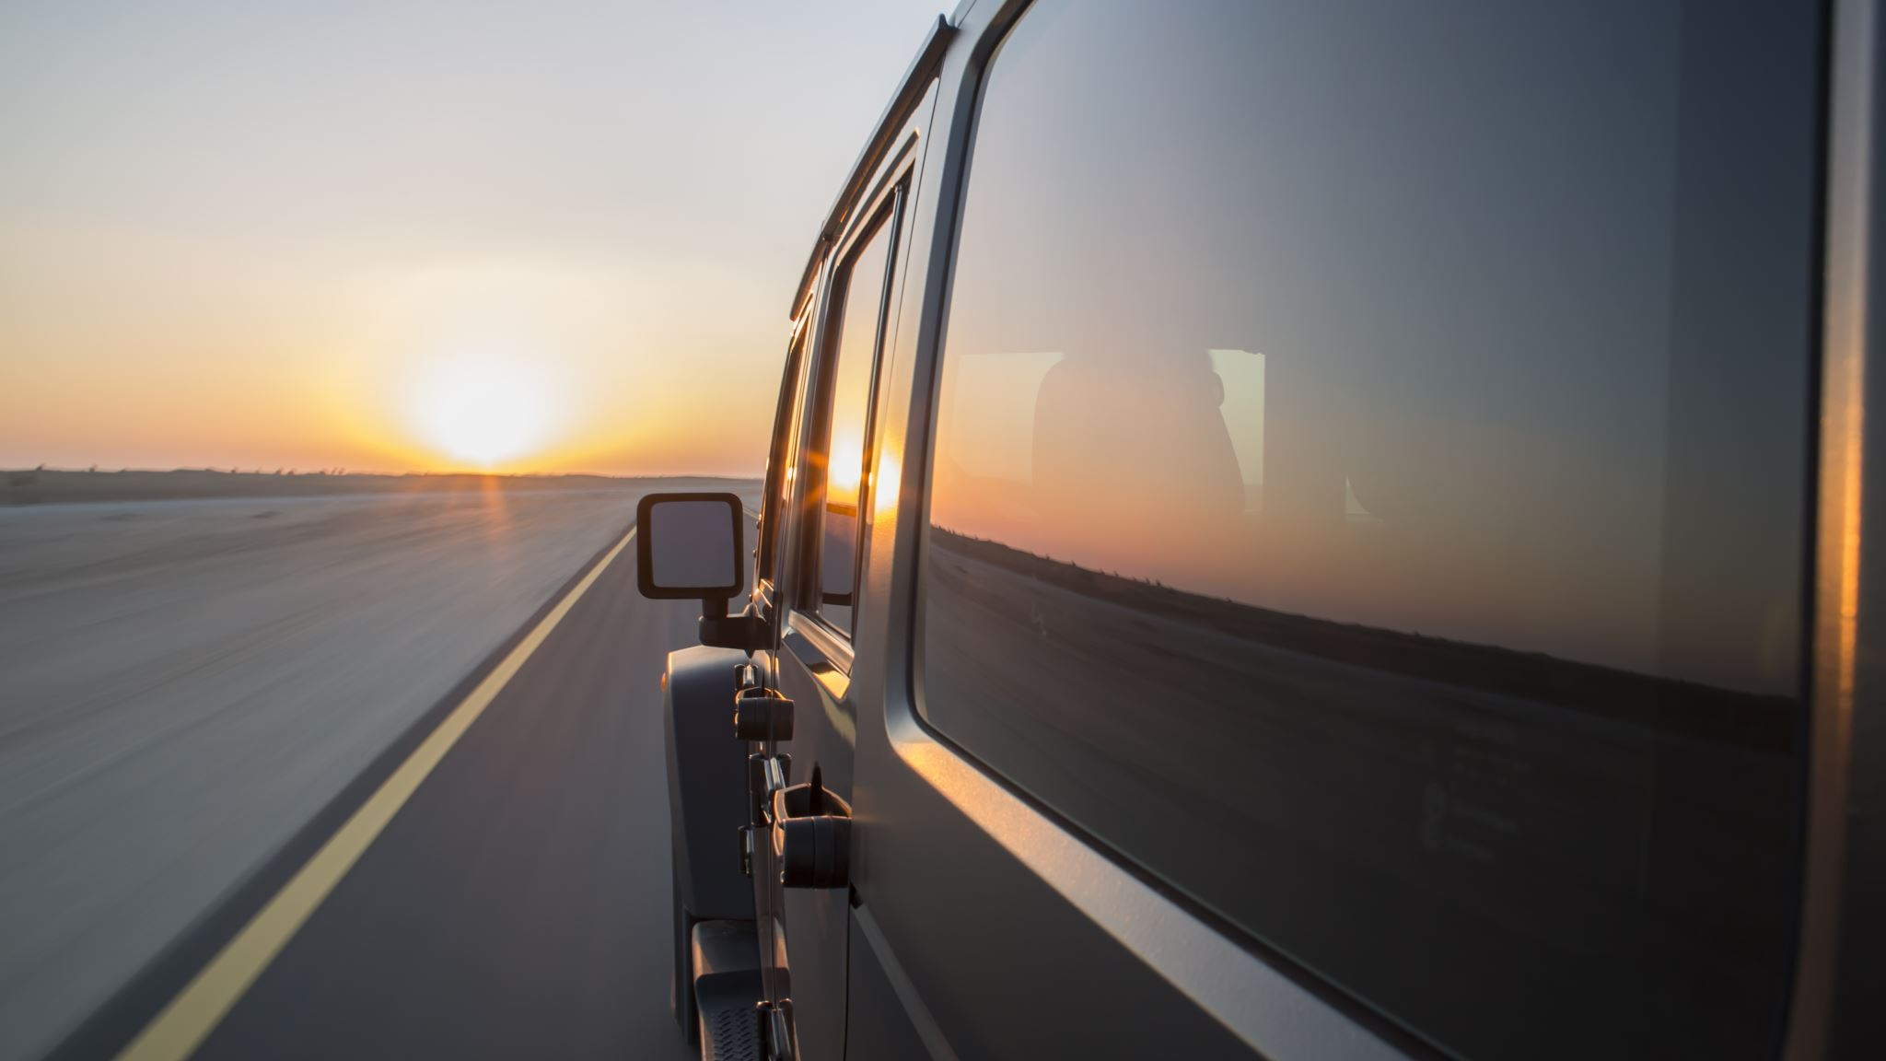
Driving into the Sunset
By: Grant Thompson, Arun Chakraborty, Shalin Shekhar

Slide 2
Description of the dataset
We are exploring a dataset of U.S. traffic accidents collected from February 2016 to March 2019. There are 2.25 million accident records in the dataset, covering 49 states in the US.
The Dataset includes:
Latitude and Longitude
Accident Date and Time
Weather Conditions
State and time zone
Road name and description of accident
Source: https://www.kaggle.com/sobhanmoosavi/us-accidents

Slide 3
Core Hypothesis
We wanted to see if the glare from the setting sun has an affect on accident prevalence for westbound traffic immediately preceding sunset (30 minutes prior to sunset)
Our hypothesis is accident prevalence is higher when driving west close to sunset, as the glare would affect your visibility.
Weather condition has an impact on traffic accident prevalence
Higher accident count during rush hour (7am-10am & 4pm-7pm) compared to rest of the work hours ( 10 am to 4 pm) or rest of the hours of the day (7 pm – 7am)
4.Higher accident count during weekdays vs. weekends

Slide 4
Data exploration and cleanup For the sunset glare analysis:
Started with 2.25 million accident reports and parsed the data to include only interstate accidents.
Then we split the data into four groups for each direction (northbound, southbound, eastbound, westbound)
We used the latitude, longitude and accident date to get the sunset time using the suntime python library
This gives the sunset time local to the machine (in this case, PST)
We converted the sunset time to UTC and then converted it to the local time of the accident timezone with the help of pytz python library
We filtered all data to include only traffic accidents occurring within 30 minutes of sunset using datetime, dateparser, time packages
We binned the data based on direction (N/S/E/W) and time delta (sunset time - accident time) prior to sunset('0to<5', '5to<10', '10to<15', '15to<20', '20to<25', '25to<30’ mins)
Additionally we looked at westbound traffic accident prevalence for the time period of 2 hours prior to sunset until 2 hours after sunset
Installations:
suntime, pytz 2005k

Slide 5
Data exploration and cleanup (cont.)
For weather condition analysis:
we had to clean up the weather condition data as it was all over the place (i.e. lightly snowy, freezing drizzle, volcanic ash, etc) into four bins: dry conditions, rainy conditions, freezing conditions, foggy conditions.
For rush hour analysis we put the traffic data into three bins:
Rush hour: 7am to 10am + 4pm to 7pm
Rest of the workday: 10am to 4pm
Rest of the day/night: 7pm to 7am
For day-of-the-week analysis :
the accident dates were converted to day of the week using datetime

Slide 6
Challenges
the data set was about over 200,000 after parsing only the interstates for for each direction, to calculate the sunset time for each of the accident based on the latitude, longitude and date tried the https://sunrise-sunset.org/api, since each request was an api call, the process was slow and there was connection issues with the server and the program will stop after 200 requests.
Despite adding few changes :
‘verify = false’
try, except block for the ssl connection errors
add ‘sleep’ of 1 second
Didn’t fix the connection issues after few thousand requests, had to move to ‘suntime’ python library which was considerably faster but gives the time based on the local time of the machine so had to do some conversation to utc -> accident location’s sunset time based on timezone.

Slide 7
Our Analysis Strategy
To do our analysis, we used:
Bar Chart
Pie Chart
Scatter plot
gmap
ANOVA
Independent (Two Sample) T-Test

Slide 8
Contents 1. Accidents due to sunset glare for westbound traffic
2. Accidents during rush hour
3. Accidents due to weather condition
4. Accidents for weekday vs weekends

Slide 9
Sunset glare for westbound traffic Summary of findings:
Sunset glare:
Null hypothesis is there is no difference in accident count based on direction
Our hypothesis is that accident counts are greater when the sun is setting in your face for westbound
Observations:
The total accidents were higher for N/S compared to W/E for interstates
we didn’t see an increase in the percentage of accidents for westbound traffic 1hour or 30 minutes prior to sunset compared to other directions
We were not able to reject the null hypothesis (pvalue=0.9993905395344729)

Slide 10
Summary of findings (cont)
 | 0to<5 | 5to<10 | 10to<15 | 15to<20 | 20to<25 | 25to<30
Direction
E | 175 | 186 | 193 | 189 | 197 | 181
N | 277 | 311 | 267 | 270 | 282 | 315
S | 215 | 225 | 252 | 213 | 234 | 233
W | 173 | 163 | 182 | 158 | 175 | 200
Observations:
The number accidents are highest at 25 to < 30 min bin for westbound
Accident counts are higher for north and south bound during that time delta prior to sunset
The above is derived from Independent (Two Sample) T-Test of accidents close to sunset for westbound vs east north, south and ANOVA between 4 directions accident count 30 mins prior to sunset which can be found in our jupyter notebook analysis (pvalue=1.4755919050026132e-10)

Slide 11
Summary of findings (cont)

Slide 13
Rush Hour Summary of findings
Rush Hour:
Null hypothesis is there is no difference in accident count between rush vs non rush of work hours or rest of the hours of day.
Our hypothesis is that accident counts are greater during morning + evening rush hour compared to rest of work hours
Observations:
Number of accident is higher for the rush hour ( 7am – 10m) + (4pm – 7pm) compared to non rush work hours (10am – 4 pm) or rest of the day ( 7 pm – 7 am)
An Independent (Two Sample) T-Test analysis was done for the total rush hour vs non rush hour for the work hours (pvalue=3.828605755116189e-173)

Slide 14
Conclusion
Didn’t see an increase in number of accidents for westbound 30 mins or 1 hour prior to sunset compared to other direction
There is an increase of accidents during rush hour compared to rest of the work hours
There are more accidents during each of the weekdays compared to weekends

Slide 15
Things we would have liked to try if time permitted :
Check for multiple accident data for accidents in U.S from various other sources, and try the same analysis
Find a python module that can calculate the exact direction/angle of the sunset so we can further narrow down the direction for westbound accidents for further accuracy.

Slide 16


